Slide 1
NOVEMBER CUSTOMER DAY
TEAM CS 21

Slide 2
ORIGINAL GOALS
Refine Game requirements
Refine API
Decide on technologies
Create high level system architecture
Build Prototype
Connects
Disconnects
Notes:
2 minutes

Slide 3
GAME REQUIREMENTS REFINEMENT (CHANGES TO ORIGINAL GAME SPECIFICATION)
Kill-stealing enabled
All the spoils of a battle go to the ship which dealt the killing blow
Delay: a randomly generated time delay of between 1-10 seconds (This was suggested)
We decided to get rid of the delay as we felt it would be frustrating
Rate of growth: Originally the ships were going to increase/decrease in size by the radius of the ship.
However we decided that it would be more balanced if we increased by area instead as the ships would grow too quickly.

Slide 4
REFINEMENT OF API
Connect
Establishes connection from client to server (Returns token and ID)
Disconnect
Disconnects player whose token is 'token’ (Returns nothing)
Accelerate
Accelerates ship in given direction. Magnitude of accelerations is what the player chose, scaled down if the player does not have enough energy (Returns nothing)
Fire
Fires an energy cone around "direction", of width 2 * "width" degrees. Power depends on the energy supplied. (Returns nothing)

Slide 5
REFINEMENT OF API CONTINUED
Scan
Scans a cone around "direction", of width 2 * "width" degrees. The range of the scan depends directly on how much energy is supplied. (Returns an array of ships(ID) and their locations)
PassiveScan
Passive (no energy consumption) scan a short range around the ship. (Returns the same as scan)
ShipInfo
Get information about the player-controlled ship.(Returns information about the users ship e.g energy)

Slide 6
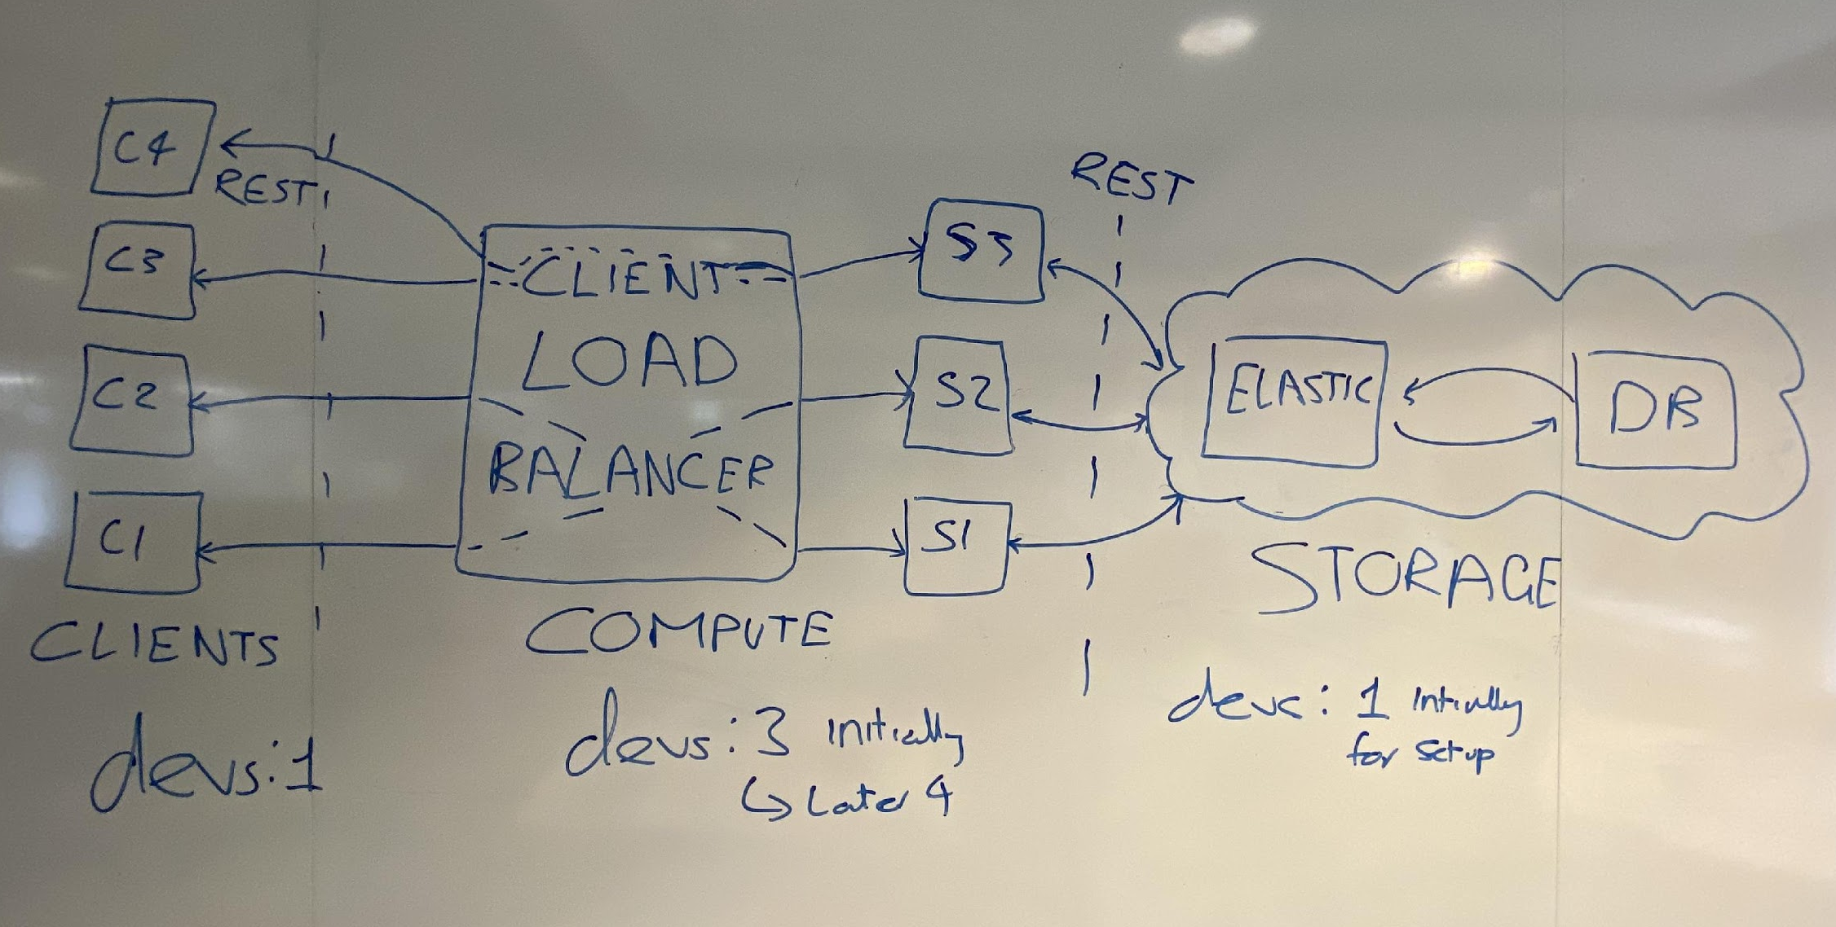
HIGH LEVEL DESIGN

Slide 7
TECHNOLOGIES
For the API: we should use REST as it is a widely-used industry standard and it is easy to use for an end user
We must consider the server must run on Linux, whereas the client there is no platform requirements
Client-side we want to provide a skeleton client: so we would like easy to use language which the user could pick up, so we chose Python

Slide 8
TECHNOLOGIES CONTINUED
Looked into other alternatives such as MongoDB for the search, however, MongoDB seemed harder to integrate with the compute node.
Whereas as ElasticSearch is very well documented and is a fast yet scalable data retrieval system.
On the server (compute node) side:
Initially we were considering Rust for the server side; however, Rust is a fairly new language compared to C#, and .NET core is stable and feature-packed.
Mostly the tooling support for C# is better than for Rust (autocompletion, linting).

Slide 9
PROTOTYPE
We have built a working prototype which has a test client that connects and disconnects using the API
We shall now demonstrate it working now!

Slide 10
ISSUES
ASP.NET was not suitable to our use case -> replaced with System.Net.HttpListener
Difficult to follow documentation; framework is very big and flexible but we don’t need all that power
Assumes that your application uses a SQL database, but Elastic is not one of the options
CI pipelines stalling
Pipelines start a compute node in the background but failed to kill it after testing and hang until 1 hour timeout - known bug in GitLab CI
Solved by creating a separate script
We don’t have a server to test on - testing on the CI VM can be impractical

Slide 11
GOALS FOR NEXT ITERATION
Get full prototype working
Moving
Shooting (incl. handling player deaths)
Scanning
Shield (without modularity)
Start better planning of horizontal scalability
Investigate cloud providers and ways to have multiple compute nodes
Judging by previous goals completed and time constraints due to the upcoming exam period, we believe that these are the achievable goals for next iteration.
The goals will be documented on our GitLab issue tracker

Slide 12
IS THERE ANYTHING MISSING
Before moving on to the next iteration,
Is there anything that we haven’t covered?
Is there anything ?

Slide 13
IMPLEMENTATION DETAILS
Use ElasticSearch Shapes to handle broadphase collision for shooting/scanning
Refine this broadphase collision in the compute node
Spaceship bounding circles are stored as octagons on ElasticSearch to get initial collision detection
Scanning/shooting viewcones are sent to ElasticSearch as simple triangles
The compute node gets the broadphase octagon/triangle collision results from ElasticSearch directly
It then does narrowphase circle/viewcone intersections by itself (by checking length(viewCenter - targetCenter) + targetRadius <= viewDistance)

